Slide 1
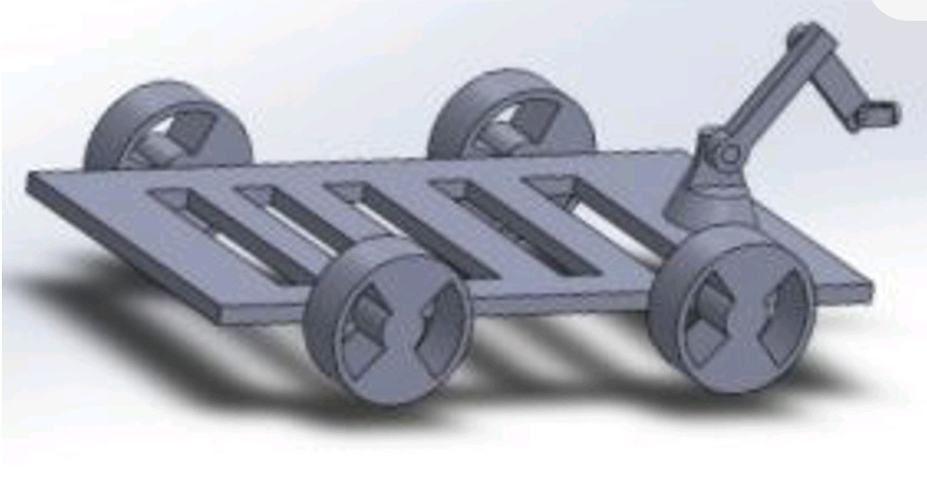
ENPM-661
PROJECT 5
PLANNING FOR TOY CAR USING RRT AND RRT* ALGORITHMS
-GIRISH KUMAR
-LAVANYA SURESH

Slide 2
INTRODUCTION
For this particular project, we decided to work on RRT and RRT* path planning algorithms.
Here, we are using a toy car based mobile robot which has a manipulator on the top that picks up the items and drops it whenever required.
The four wheeled mobile robot has a base which is made of rubber tier and it is driven by the effort velocity controller.
We applied the learning of the algorithms in toy car by leveraging the power of simulation through gazebo, ROS and python.

Slide 3
RRT AND ITS ADVANTAGES
RRT is a path planning algorithm that randomly explores the working area that is filled with obstacles to find the optimal path between start and goal nodes.
This algorithm is designed for efficiently searching paths in a non-convex high dimensional spaces.
The algorithm works faster as compared to other path planning algorithms.

Slide 4
COMPARISON
RRT ALGORITHM | RRT* ALGORITHM
Fairly faster | Computationally expensive
The path is quite longer | It gives optimal short path
Doesn’t choose the best parent node when assigning the nearest neighbour | Chooses the best parent node in the vicinity based on cost-to-come
No rewiring of neighbours | Rewire the neighbours in the vicinity if there is a short path based on cost-to-come

Slide 5
Workflow
We are simulating the RRT / RRT* algorithm in python.
Output text files will be generated with control actions in it (similar to project 3c).
Using the text files, simulation will be carried out for the toy car in gazebo.

Slide 6
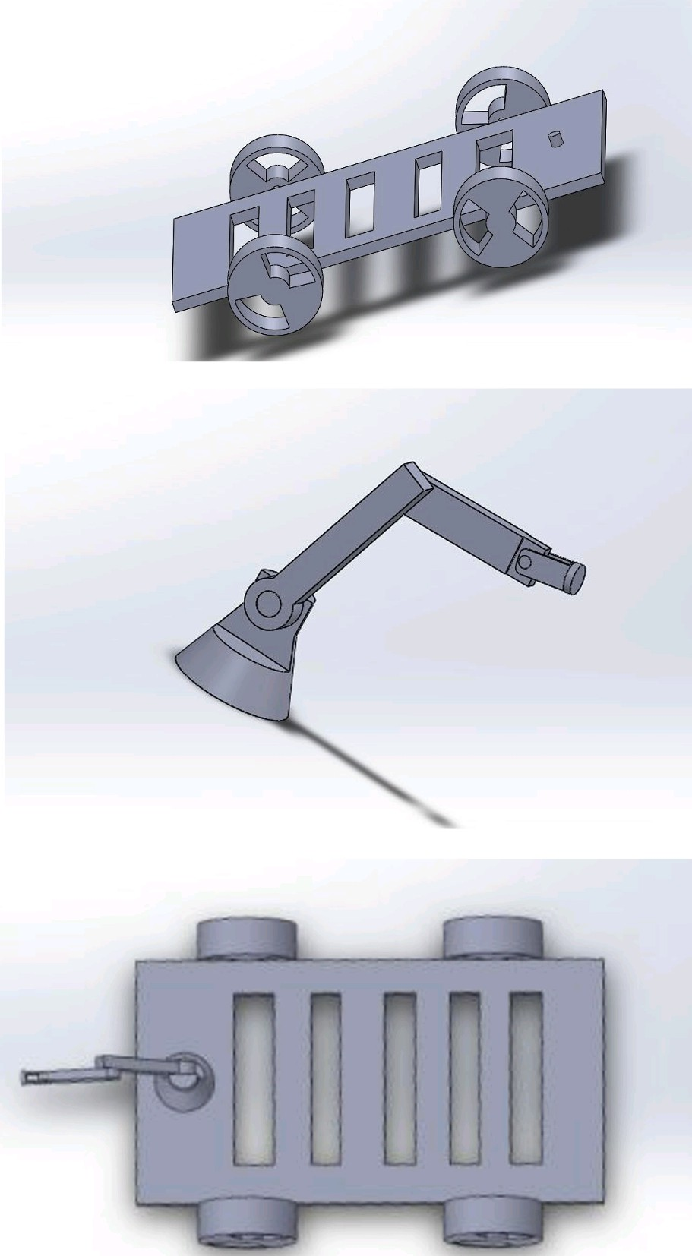
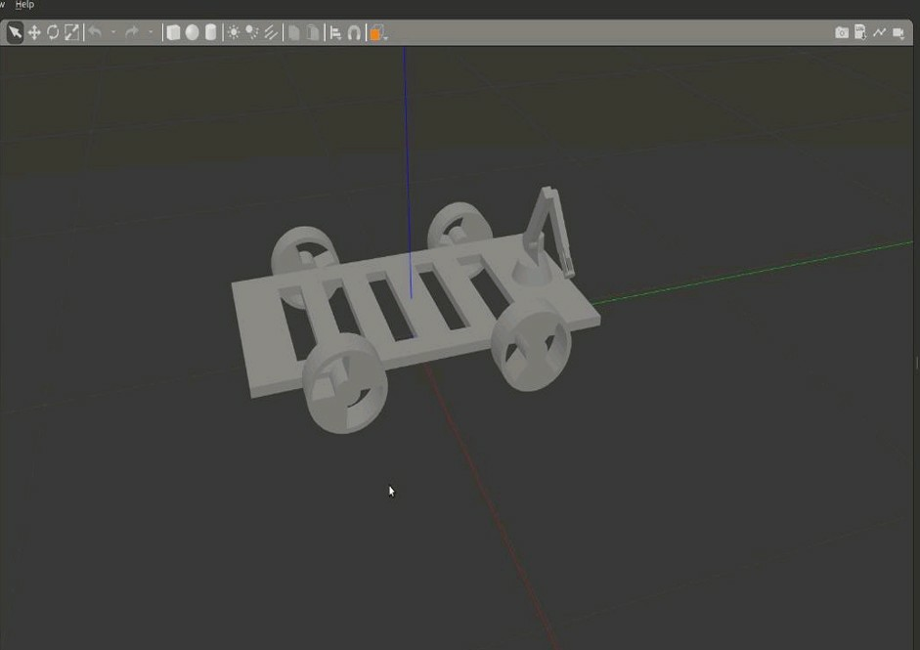
Toy Car

Slide 7
Toy Car Description
The CAD model will be assumed to be a homogenous material with no irregular pores.
The physics will be assumed to be correct i.e the model will stand upright.
The servo motors will be assumed to be attached at each joint.
The torque calculations will be assumed to align according to each joint.
The ground to base joint will be assumed to be fixed hence no movement.
No lag will be assumed between controller and actuator.
No external friction between the joint.
Credits - Divyam Garg and John Dinofrio

Slide 8
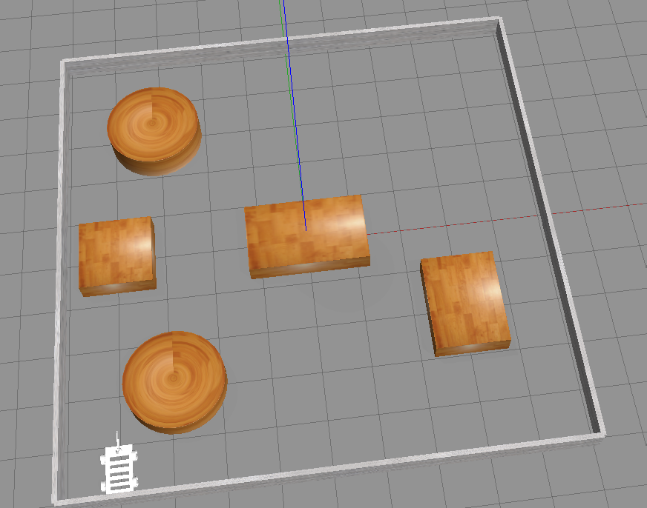
World Map

Slide 9
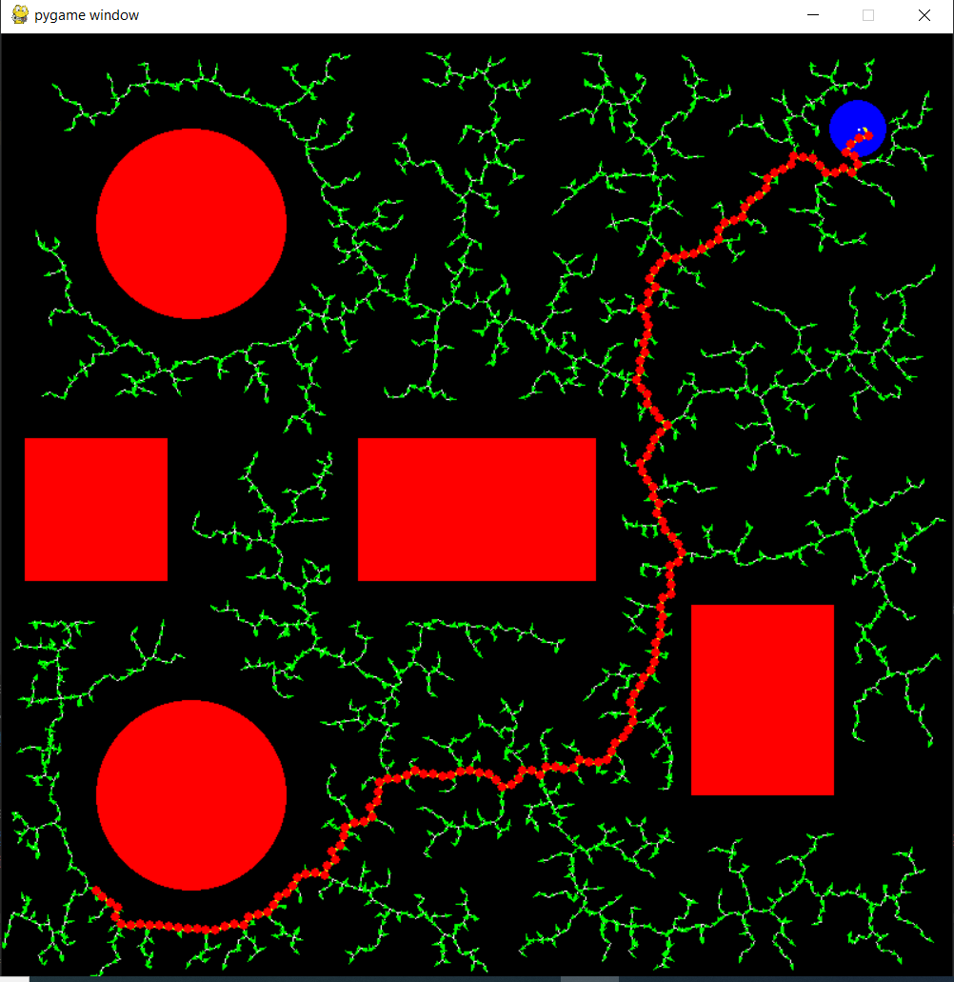
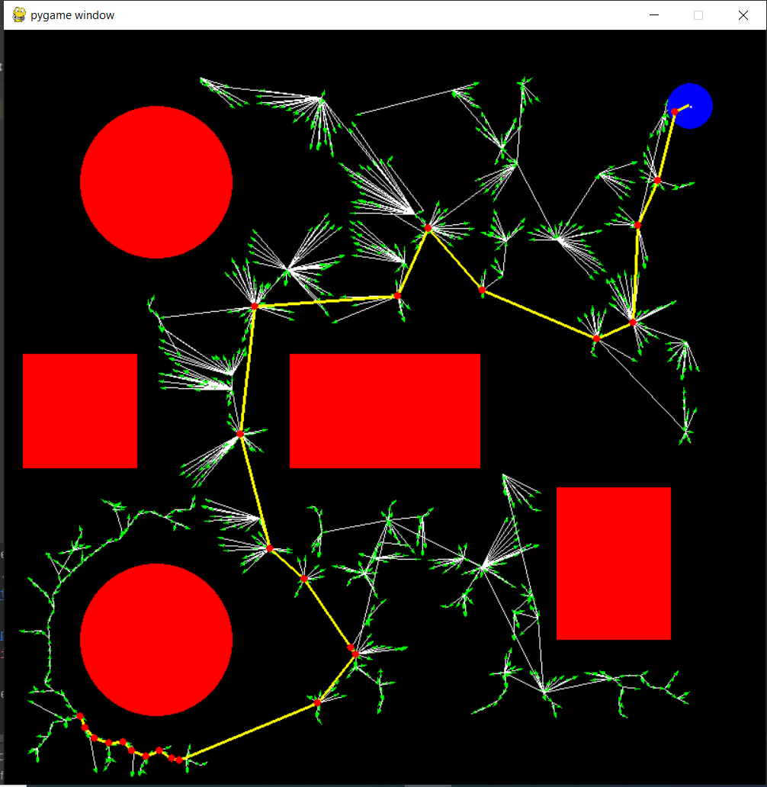
Results
RRT
RRT*
TODO
4-wheel drive for toy car is yet to be implemented in Gazebo!

